Slide 1



Shaders
Dissolve
Akis Zachariadis - Games Dept. Coordinator

Slide 2
Manipulation Elements
Surface Elements
Textures, Emissive, Specular etc.
UVs
Scrolling, Scale, Twist
Object Position
Vertex Position, Normal Vector, Camera Position

Slide 3
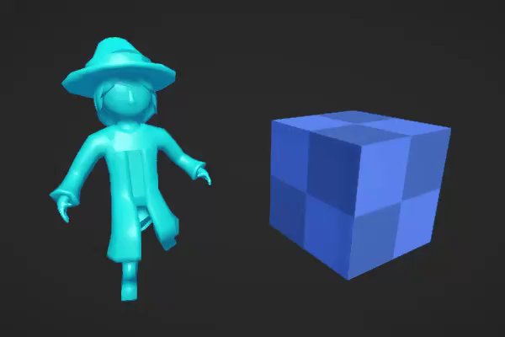
Dissolve Effect Breakdown
Transparency based on Noise Texture
Generate Noise Texture, Sample Noise Texture
Noise Edge Width
Noise Edge Color
Scrolling across the object
Dissolve based on the Y of the Object

Slide 4
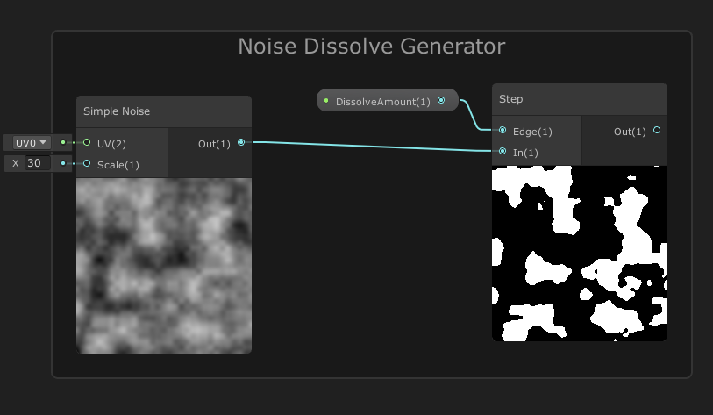
Dissolve Noise Texture
We can use the node Simple Noise or Gradient Noise to generate the Noise Texture for the Dissolve Effect.
For performance reason we can use a noise texture and sample it. [Mobile]
The noise texture generates values between 0-1. Because we want to have parts of the object either opaque or full transparent we want the values to be 0 or 1.
The Step node based on a value pushes the values to 0 or 1 based if they are bigger or smaller to a specific amount. In our situation it is based on the Dissolve Amount

Slide 5
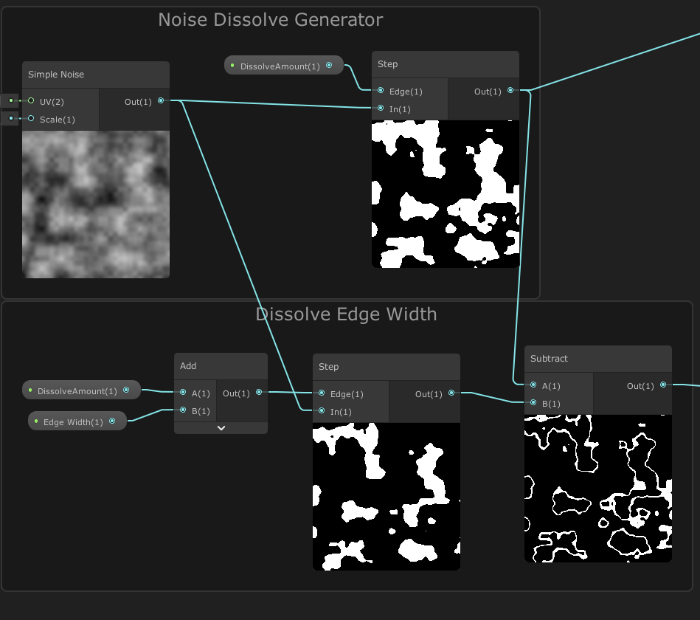
Edge Width
In order to create an edge at the end of our dissolve effect we need to create a space that we can control the width and apply color.
For this reason we will create a smaller version of our dissolve texture and we will subtract it from the bigger version. The result of the subtract will be the difference which means the edge width space that we wanted
To create a smaller version of the dissolve texture we will have to use again the Step Node and for the Edge input we will use the DissolveAmount property but we will add a really small number. (0.05)

Slide 6
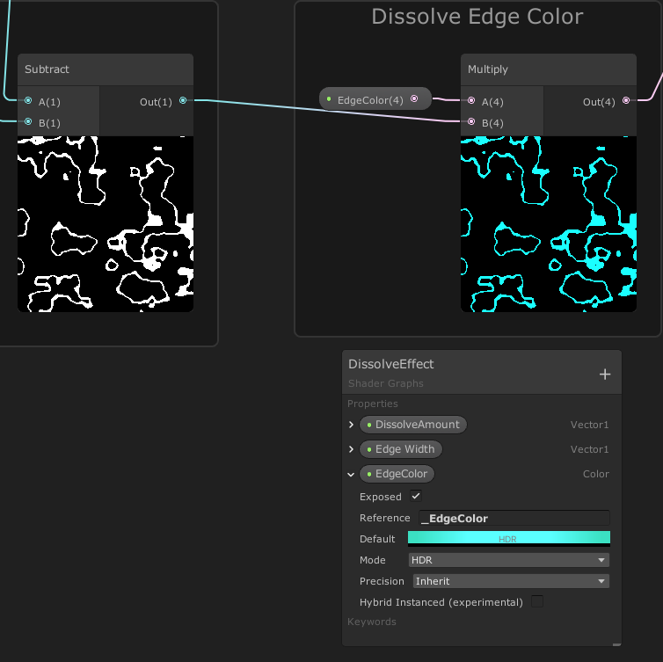
Edge Color
For the Edge Color we will have to multiply the result of the subtract with a color property.
If we use a PBR graph we can connect the multiply result to the emissive input.
For the glowing effect we will have to use a bloom post process in Camera.
Also, in the color node use the HDR mode and increase a bit the intensity
However if we use an Unlit Master node, since it only has a Color input, we must use a Lerp node in order to interpolate between the texture and the dissolve.

Slide 7
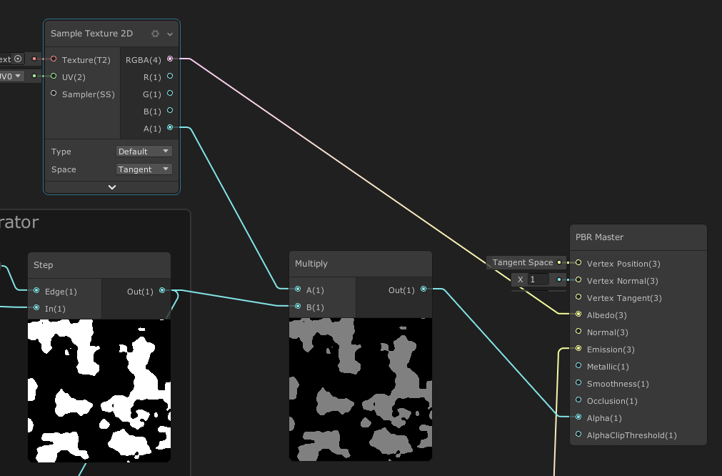
Dissolve Based Transparency
To create the transparency effect based on our dissolve we must multiply the result of the step node with the small edge amount with the Alpha component of our main texture.
We will insert the result of the multiplication to the Alpha input of the Master node.

Slide 8
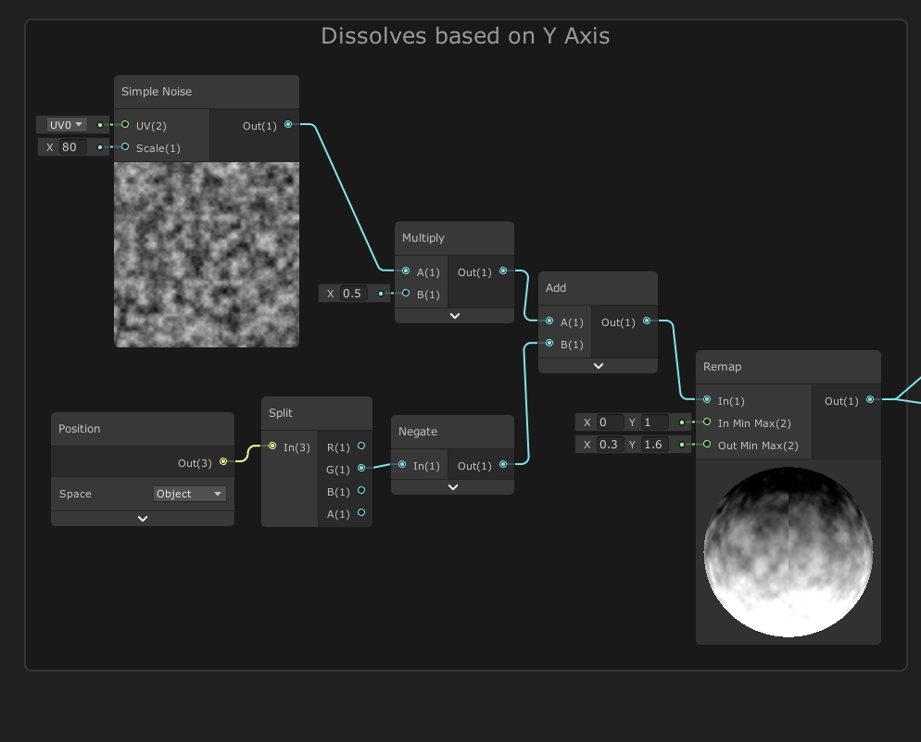
Dissolve Based on Height
Our current effect dissolves uniformly across the mesh/object. We can add a feature to our dissolve effect to follow specific axes of our object.
For this behavior we can use the Position node and obtain the Y axis of the object. In order to obtain it we must use the Split node and get the G output.
If we want the dissolve effect to stay fixed on the object axis regardless of rotation and scale we must use Object Space otherwise we must use World Space.
We will add this onto the noise output, but first we will negate it, to make sure the dissolve effect starts with an DissolveAmount of 0.
Because we add values to the Noise we move the values outside the range 0-1 so we need to remap them.

Slide 9
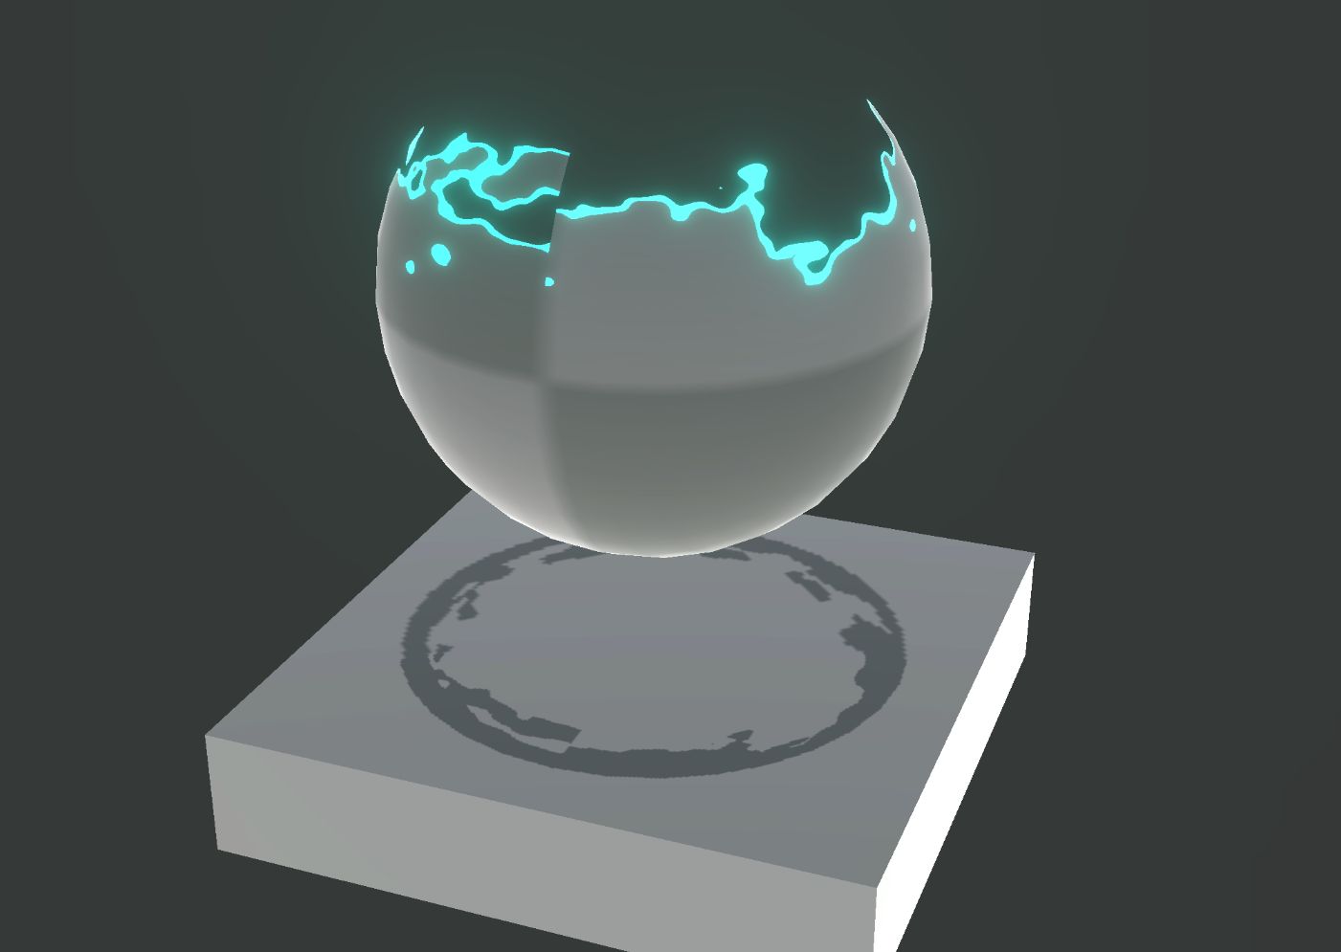
Issues
Visible Seams
Use triplanar texturing or view space
On view space as the camera moves the texture noise will follow the movement
If we want to avoid this effect we can offset the view position with the object’s origin.
Using this method means that every object shares the same set of noise.

Slide 10
Challenge #7
Add scrolling animation on the dissolve effect
Add edge color change when it is scrolling
Create 2 variations of noise texture: Voronoi and Gradient Noise
Add twirl effect on the noise textures
Add script functionality: When you approach the object it starts dissolves

